Slide 1
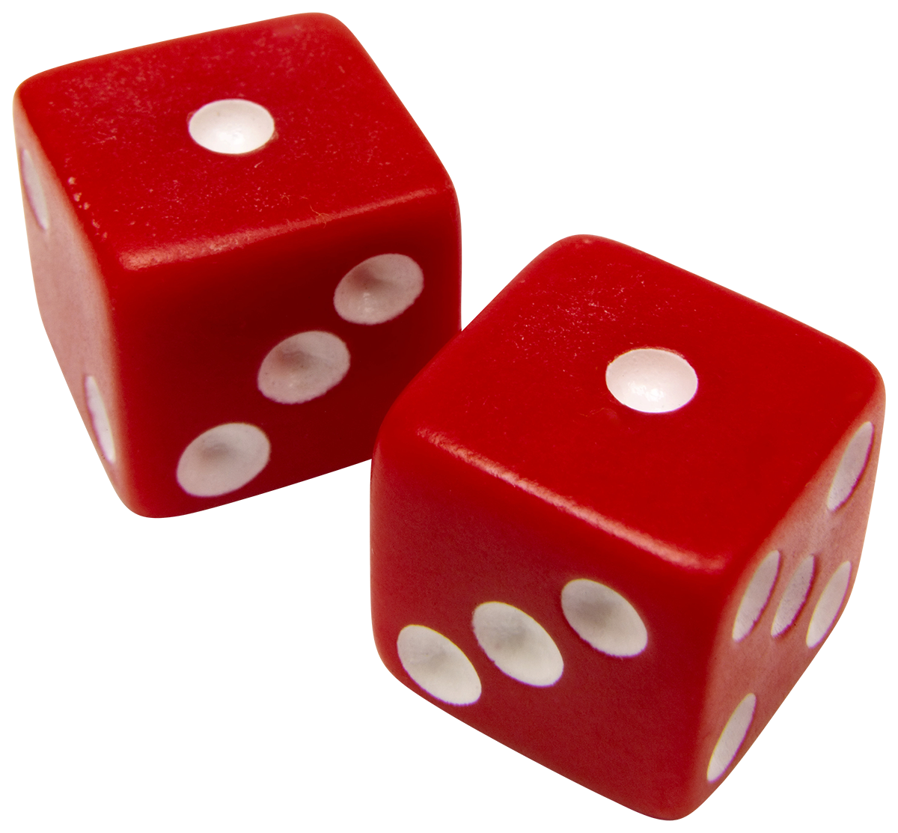
Games for your ESL class. It is silly but it works!
Tatiana Taratynova
AELG Program Montgomery College
March 5, 2016

Slide 2
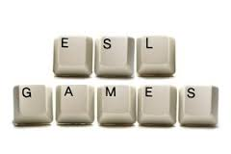
Why games?
Fun ( Who is yawning now)?
Real-life simulations
Peer support – ask a friend for help
Student-centered learning
Task-based learning
Consolidate vocab and grammar structures

Slide 4
Game is..
`Game' to mean an activity which is entertaining and engaging, often challenging, and an activity in which the learners play and usually interact with others. A testing question might be: `Would the learners be happy to do this activity in their own language?’
Andrew Wright. Games for Language Learning (Cambridge Handbooks for Language Teachers) (Kindle Locations 143-144). Kindle Edition.

Slide 5
Language Learning is Hard Work
One must make an effort to understand, to repeat accurately, to adapt and to use newly understood language in conversation and in written composition. Effort is required at every moment and must be maintained over a long period of time. Games help and encourage many learners to sustain their interest and work.
Andrew Wright. Games for Language Learning (Cambridge Handbooks for Language Teachers) (Kindle Locations 149-150). Kindle Edition.

Slide 6
Positive Emotions
Games involve the emotions, and the meaning of the language is thus more vividly experienced. It is, for this reason, probably better absorbed than learning based on mechanical drills

Slide 7
Basics
Make sure students are comfortable with the game and adjust accordingly ( culture, speed, topic)
Game should correspond to the lesson plan ( vocab/grammar/ listening)
Easy instructions
Set time limit ( 5 minutes)
Games can be a reward + unexpected ( to break the routine)

Slide 8
Games are good for students
Vocabulary
Grammar
Oral Comprehension
Writing
Listening

Slide 9
Game are good for teachers
Indicate if student know the material
Show student’s comfort level with the language use
Reinforce accuracy and fluency

Slide 10
Linguists say..
Celce-Murcia and Macintosh (1979), state that in games, language-use takes precedence over language-practice, and games bring the student closer to the real-world situation through its task-oriented characteristics.

Slide 11
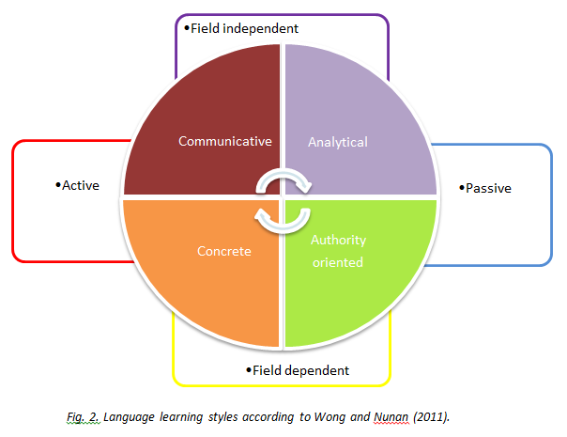
Learning Styles
Willing (1985, cited in Nunan 1988, 93) found four different learner types :

Slide 12
Concrete Learners
Concrete learners: These learners preferred learning by games, pictures, films and video, talking in pairs, learning through the use of cassettes, and going on excursions.

Slide 13
Analytical learners
:
These learners liked studying grammar, studying English books, studying alone, finding their own mistakes, having problems to work on, learning through reading newspapers.
.

Slide 14
Communicative learners:
This group liked to learn by observing and listening to L1 speakers, talking to friends in English, watching TV in English, using English in shops, and so on, learning English words by hearing them and learning by conversations.

Slide 15
Authority-oriented learners
Authority-oriented learners:
These students liked the teacher to explain everything, writing everything in a notebook, having their own textbook, learning to read, studying grammar, and learning English words by seeing them

Slide 16
Good Language Learner
Tolerance of ambiguity
Creative and experiment with the language
Let the context help them in compression
Learn to make intelligible guesses
Learn “chunks of languages” as “ wholes”
Learn production techniques ( keep the conversation going)
Learn different styles of speech
Rubin, J. (1975). "What the "Good Language Learner" Can Teach Us". TESOL Quarterly 9 (1): 41–51. doi:10.2307/3586011

Slide 17
Data on games
Stapleton, P. (2013). Using conference submission data to uncover broad trends in language teaching: A case study of one conference over 30 years. Language Teaching Research, 17(2), 144-163. doi:10.1177/1362168812460808

Slide 18
Data

Slide 19
Data ( 2010)

Slide 20
Most cited

Slide 21
Games
Games
With Technology
Group
Solo

Slide 22
Tech Games
Cell Phones can be friends!
http://quick.as/nyyt7b
https://getkahoot.com/
Advice: Make sure everyone has a cell phone + provide an additional device

Slide 23
Games with Prep
Hadfield, J. (1980). Beginner communication games
Hadfield, J. ( 1997) Intermediate communication games
http://www.amazon.com/Jill-Hadfield/e/B0034OMA7K/ref=sr_ntt_srch_lnk_1?qid=1456421899&sr=8-1

Slide 24
Easy- No prep Speed Dating
any topic for drills ( greetings, time, schedule), likes/dislikes , etc.
1-2 minutes per drill or per “ date”
Visuals ( textbook or white board for beginners)
Multiple opportunities to use “ structure” or “vocab”
Advantages: everyone is involved
Culture: Make sure Ss are comfortable

Slide 25
Stand in Line
Language Interacting with others using minimal language
Preparation: None
Names in alphabetical order
Date of birth
Favorite month
Zodiac sign
Favorite times of the day

Slide 26
Speed dating
English | Russian
Hi | Privet ( friends) Dobry Den ( everyone else)
How are you? | Kak dela?
Fine, thanks! And you? | Horosho, spasibo A u tebya ( informal)? A u vas ( Formal)?

Slide 27
Speed Dating Questions
What's your name?
Where do you live?
What's your job?
Do you have children?
What's your hobby? What's your favorite food/music?
What would you if you won a lottery?

Slide 28
Guess the word
Two rows of students, students stand back to the board
Teacher writes a word and the group that sees the board explains the word
Consolidates vocab, enriches speaking techniques

Slide 29
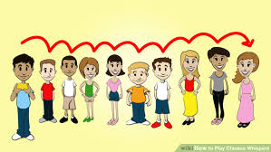
Chinese whispers
Active word from the lesson
Two teams compete – who writes the word faster and more accurate

Slide 30
Memory- Standing up
Topic: Clothes and Colors
Who is wearing blue?
Who is wearing jeans?
Who is wearing a red sweater?
Student take a step forward and step back to their line. At the end of the game, ask to name Ss to point at each other

Slide 31
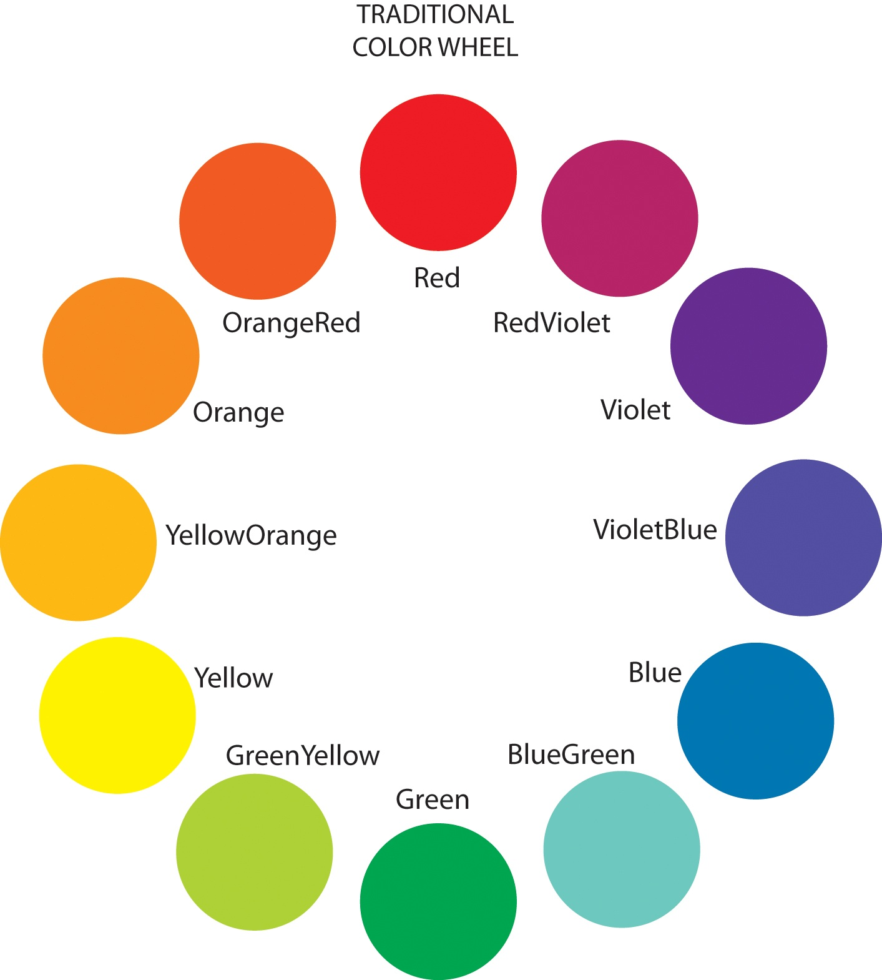
Colors
https://en.wikipedia.org/wiki/Lists_of_colors

Slide 32
Magenta calls Beige
Can use colors ( blue CALLS black) or names/ job titles
Consolidates 3rd person singular in Present Simple
Can practice a different tense and verb ( Present Progressive, Present Perfect, Past Simple)
Can be modified – instead of colors can use active vocab from your lesson ( Money, Clothes, Food, etc.)

Slide 33
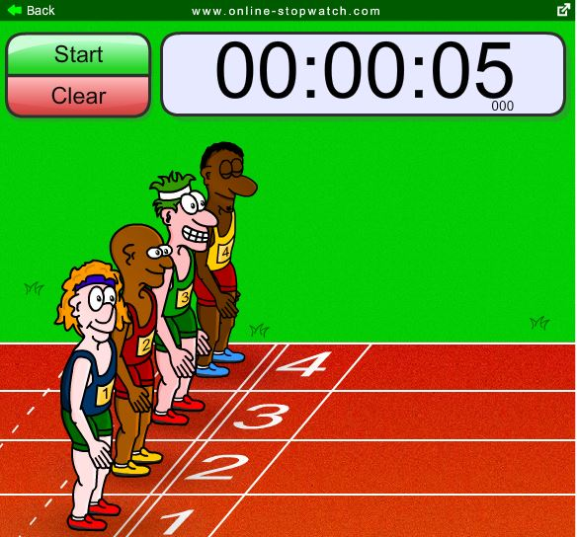
Board racing game
Students can edit each other’s work
Teams ( up to four)
Irregular verbs
Adjectives
Numbers
Reward: Points, Stickers, Candy

Slide 34
Newspaper bashing
Divide students into groups ( 5-6 students)
Drill active vocab +
Choose a topic ( food)
Limit it to a narrower field ( Breakfast food)

Slide 35
Newspaper bashing 2
Pick a topic ( Regular- Irregular Verbs)
Students take turns in bashing the correct notion
Group scores

Slide 36
Books with games
Rinvolucri, M., & Davis, P. (1995). More grammar games: Cognitive, affective, and movement activities for EFL students. Cambridge: Cambridge University Press.
Ur, P., & Thornbury, S. (2012). Vocabulary activities. Cambridge: Cambridge University Press.
Hadfield, J. (1980). Beginner communication games.
Wright, A., Betteridge, D., & Buckby, M. (1984). Games for language learning. Cambridge: Cambridge University Press.

Slide 37
References
Celce-Murcia, M., & Macintosh, L. (1979). Teaching English as a second or foreign language, 241-257. Rowley, Ma.: Newbury House.
Ellis, R. (2008). The study of second language acquisition. Oxford: Oxford University Press.
Long, M, Ritchie, W. C., & Bhatia, T. K. (1996). Handbook of second language acquisition. San Diego: Academic Press.
Rubin, J. (1975). "What the "Good Language Learner" Can Teach Us". TESOL Quarterly 9 (1): 41–51. doi:10.2307/3586011

