Slide 1
Symbaloo & You!
Adaora Nwigwe, College & Career Coach

Slide 2
Symbaloo & You
Agenda:
  Overview of College and Career Coach Program
  What is Symbaloo?
  How to use Symbaloo
  Symbaloo in the Classroom

Slide 3
College and Career Coaches
Began over 5 years ago to assist and provide ALEG students college and career information and resources
Who We Are:
  Experienced professionals in career counseling
  Pervious experience working with English language learners and GED students in various settings
Where We Are:
  We cover 8 to 10 sites, with ability to visit additional sites upon request

Slide 4
Career Coaches & Locations
Location | Coach Name | Workshop Day(s) (coach is on site two days a week except TPMS) | Time
Gaithersburg HS-ESOL | Jackie Williams | M/W | 6:00pm – 9:00pm
Seneca Valley HS-ESOL | Jackie Williams | T/R | 6:00pm – 9:00pm
Westfield South-ESOL | Adaora Nwigwe | M/W | 6:00pm – 9:00pm
Westfield South-GED | Constant Amoa | M/W | 12:00pm – 3:00pm
Quince Orchard HS-GED | Constant Amoa | T/R | 5:30pm – 8:30pm
Takoma Park MS-GED | Darrell Burns | W | 5:30pm – 8:30pm
Richard Montgomery HS-ESOL | Darrell Burns | T/R | 6:00pm – 9:00pm
Kennedy HS | Herman Pryor | T/R | 6:00pm – 9:00pm
Kennedy HS | Herman Pryor | S | 11:30 am – 1:30pm

Slide 5
College and Career Coach
What Do We Do:
  Provide college and career coach services
    to small groups via workshops
    by appointment on an individual basis,
    in class presentations per faculty request
Why We Do What We Do:
  To bridge the gap - students are still struggling to find relevance that coursework will have on their future
  Students are looking to transition to a multitude of education and career/jobs

Slide 6
College & Career Coach
Why We Do What We Do (cont.):
  Increase academic achievement
  Increase number of students transitioning to post-secondary institutions
  Increase in completion rate
  GED 2014 is aligned to the College & Career Readiness Standards

Slide 7
What is Symbaloo
A Visual bookmarking tool
Simplifies organizing information into one space
Puts favorite websites at fingertips
Allows others to find information/resources easily
Can be accessed on any electronic device (Tablet, Cell phones, Laptops/computers)

Slide 8
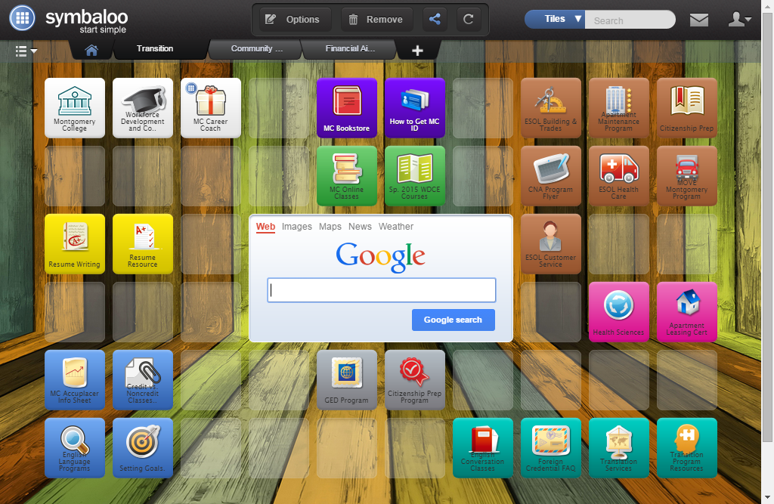
What is Symbaloo

Slide 9
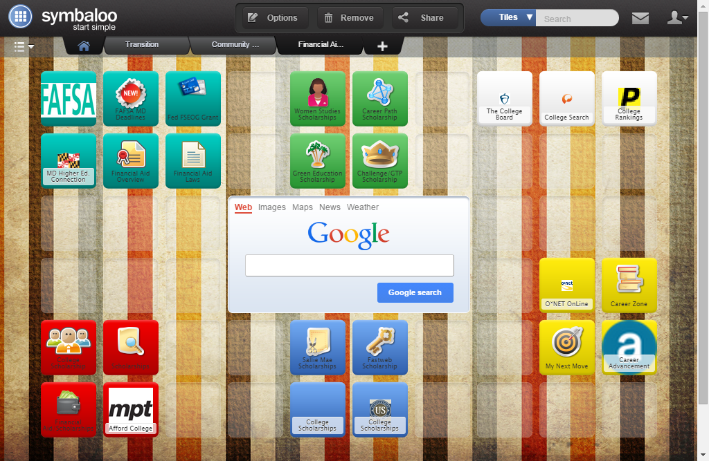
What is Symbaloo

Slide 10
C&CC Symbaloo Usage
Symbaloo has allowed us to compile information for ALEG students into one location
Students are able to access transitional information, county resource information and financial aid and scholarship information
This is a living website, with some information being updated daily, weekly or monthly

Slide 11
C&CC Symbaloo Usage
Currently we have created 3 main tabs
  Transition Information Tab
    Information on MC and ALEG programs, events and recourses
  MC County Resources
    Assistance with housing, food, clothing, mental health issues
    English conversation clubs, library hours and locations,
  Financial Aid
    Online career options
    Scholarship information for MD and beyond

Slide 12
Symbaloo & the Classroom
Can be used to build resumes through the online career coach software
  You are also able to include the resume lesson in Symbaloo for easier access by students
    Example: Lesson’s tab
Researching information for homework assignments
View videos on various topics

Slide 13
Contact Information
Adaora Nwigwe, M.A., MBA
College and Career Coach
Adaora.nwigwe@montgomerycollege.edu
Chauncy L. Butcher, M.S., CPP
Transition Program Coordinator
Adult ESOL and Basic Skills for College & Careers
Phone: 240.567.8834
Chauncy.butcher@montgomerycollege.edu

