Slide 1
Supporting Writing in the class
Presenter: Comfort Davis Mingot M.Ed. Comfort.Mingot@montgomerycollege.edu

Slide 2
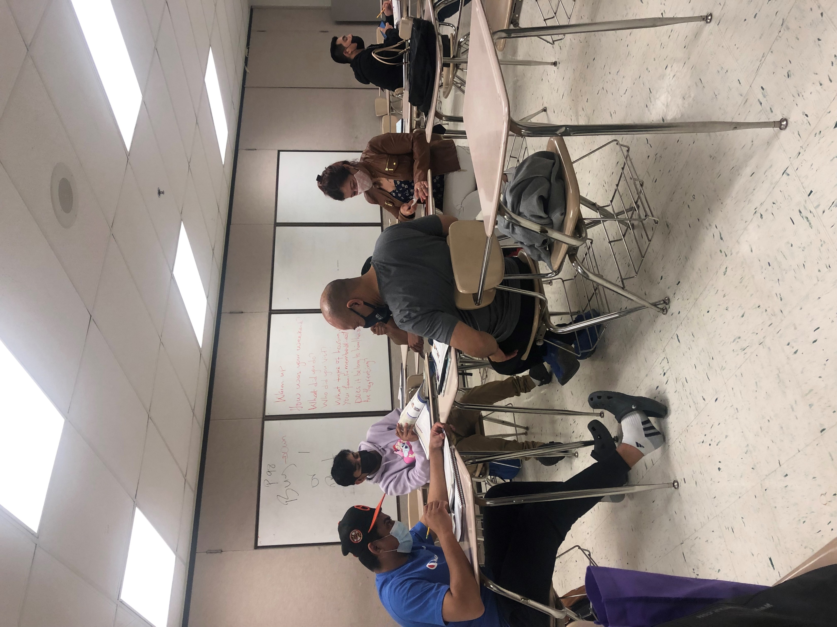
Writing in the classroom

Slide 3
Background
Writing is a complex skill. Researchers, Rogers, and Graham mentioned in their studies on writing intervention that,
“There is considerable concern that students do not develop the writing skills needed for school, occupational, or personal success. A frequent explanation for this is that schools do not do a good job of teaching this complex skill. A recent meta-analysis of true- and quasi-experimental writing intervention research (S. Graham & D. Perin, 2007a) addressed this issue by identifying effective instructional writing practices. ”Teaching writing is a bittersweet adventure.

Slide 4
Outcomes
Enhance instructors’ expertise in describing essential elements of effective interventions for teaching and supporting written expression,
Select and implement strategies for scaffolding academic, social, and professional writing,
Identifying technology tools that support writing production.

Slide 5
Ideation-warm-up
Ideation is often closely related to the practice of brainstorming, a specific technique that is utilized to generate new ideas. A principal difference between ideation and brainstorming is that ideation is commonly more thought of as being an individual pursuit, while brainstorming is almost always a group activity.
Notes:
https://padlet.com/comfortdavismingot/Bookmarks

Slide 6
Ideation
The goal is to try to think of as many solutions as you can without worrying about how ‘good’ the solutions might be.
In two minutes, pick one of the questions below
Questions:
1. How could you heat up a bowl of soup without a stove or microwave?
2. How could you teach writing to students at the literacy or low beginning levels?
3. How could you teach students at the Advanced or GED level to write an argument essay.
4. How could you become the AELG Program’s Teacher of the Year?
5. • How could you open a jar without touching it directly with your hands?

Slide 7
Discussion
Briefly discuss the exercise.
a. Did you find it easy or difficult to brainstorm solutions?
b. Did you think any of your ideas were silly or wacky? Would you have included those ideas in the list if you were asked to only write down ideas that you thought were ‘good’?
c. Do you think there is an advantage to brainstorming as many ideas as you can and not worrying about how good, bad, silly, or strange they might seem?

Slide 8
Why is this Presentation Relevant?
Writing is an invaluable academic, social, and professional skill, especially for English as a second language learners. This presentation provides teachers with advanced –beginning levels writing activities and exercises designed for students of different levels and abilities.

Slide 9
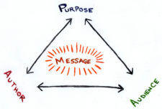
Purpose for writing in general
This Photo by Unknown Author is licensed under CC BY-NC

Slide 10

Describing essential elements of effective interventions for teaching and supporting written expression.

Slide 11
Describing essential element of Writing in the Advanced level and GED classes
Students at the advanced level or GED level need to be challenged in order to improve. They need to be able to utilize the language skills( syntax, word choice, mechanic, etc.) they have acquired through hard work.

Slide 12
An effective intervention for teaching and Supporting Writing in the
Advanced level and GED classes
At this level, they are in the position to write about topics that they feel strongly about. For example, an opinionated topic will be a great way to have advanced and
GED students practice their language skills.

Slide 13
Opinion Topics
Process food
Recycling
School policies on plagiarism
Use of cell phones in the classroom
Daylight saving

Slide 14

Say or write in the chat additional opinion topics that you are thinking of

Slide 15
Approach and strategy
Student should be encouraged to support their point of views with reasonable and substantial arguments.

Slide 16
Describing essential element of Writing in the Intermediate to Beginning level classes
Students at the Intermediate to Beginning levels acquired vocabulary and utilize them to express their thoughts and perspectives.

Slide 17
An effective intervention for teaching and Supporting Writing in intermediate to beginning level classes
Vocabulary knowledge is essential to writing.
The more vocabulary students know and can use properly in context, the better prepared they are to write about advantages and disadvantages or comparison and contrast.

Slide 18
Advantage and Disadvantage
Topics
Cell phones
Online shopping
Social media
Fast food
Immigration
Freedom of expression
Owing a business

Slide 19

Say or write in the chat additional Advantage and Disadvantage topics that you are thinking of
This Photo by Unknown Author is licensed under CC BY

Slide 20
Approach and strategy
Students should be encouraged to use the vocabulary they know to think of advantages and disadvantages.
They should utilize the point by point or subject by subject method.

Slide 21
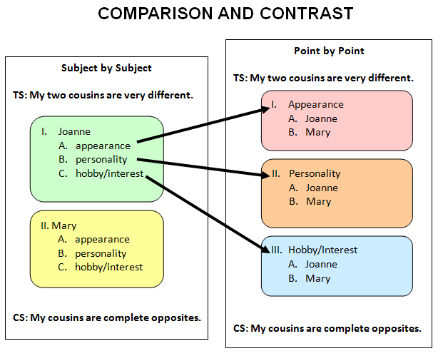
Subject by Subject and Point by Point

Slide 22
Point by Point
The point-by-point method essay is a kind of writing form in which a writer discusses the similarities and differences of two topics or ideas consecutively. In other words, one aspect of a subject and the same aspect of the second subject are discussed within the same paragraph in a point-by-point method.

Slide 23
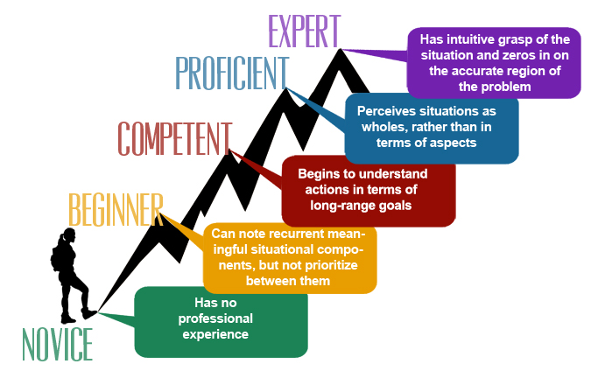
Multiple levels
This Photo by Unknown Author is licensed under CC BY-NC

Slide 24
Describing essential element of Writing in the multiple levels classes
At the multi level, students need to be provided with writing assignments that require them to use lots of description and expressions to properly communicate about a personal memory.

Slide 25
Memories Topics
Memorable holidays
Life in country of origin (how it was compared to now)
Childhood best friend
Best vacation time
Event that changed life

Slide 26

Say or write in the chat additional Memories Topics that you are thinking of
This Photo by Unknown Author is licensed under CC BY-SA-NC

Slide 27
An effective intervention for teaching and Supporting Writing in the Multi level classes
Students should be encouraged to use adjective to show and tell the event they are writing about.

Slide 28
Approach and strategies
When writing descriptive pieces, students are writing for their audience to have an understanding of a person, place, or thing. Students should try to make the object that they are describing come alive for their readers. Their readers should use their imagination and picture what is being described in their minds.

Slide 29
Summary Writing Exercise
Summary writing can be an invaluable skill for ESL students. This lesson equips teachers with classroom exercises and activities designed to teach summary writing to students of varying English language abilities.

Slide 30
Why Summaries Matter
Of all the aspects of English writing, students will encounter, summaries are perhaps one of the most valuable. One of the reasons for this is function summaries serve as condensed and focused pieces of information that can be more easily digested. Summaries can serve as the first step to understanding a larger work. Building a strong knowledge of both how to write and interpret summaries can also enable ESL to process information more effectively.

Slide 31
Class discussion
1.What is a written summary?(Ask for students feedback)
A summary provides reader with an overview of the main points of something longer.
2. What are some examples of summaries?
News headlines
Brief descriptions of movies or television shows
The back cover of a book
3. How do you write a summary?
Do focus on the main points. Do not include details.
Do use your own words. Do not copy phrases of sentences from the source
Do stick to the facts. Do not give personal opinion or change information
4. How long or how many words should a summary be?
It depends on the length of the piece you are summarizing.

Slide 32
Conversational Summaries
1. Organize students into pairs
2. Instruct the pairs to have a 5-minutes conversation about any topic. Students should take notes during the conversation.
3. When the time is up, give students a few minutes to write a summary of the conversation they had with their partners.
4. Have partners exchange their written summaries.
5. Ask each pair to explain how their summaries of the same conversation differ and address any inconsistences students find with their partner’s summaries
Alternatively, you can collect the summaries for assessment and review

Slide 33
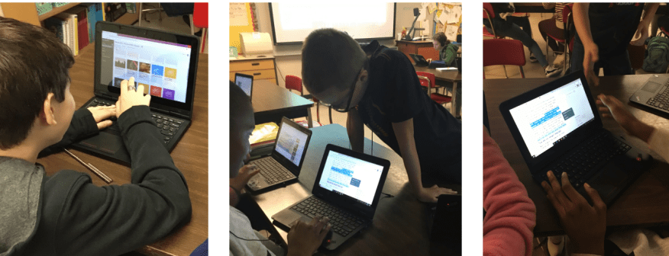
Utilize Technology to scaffold Writing
This Photo by Unknown Author is licensed under CC BY-SA

Slide 34
Word Processing
Task
Think and list all the ways in which Word Processing empowers you to work or manipulate a text.
For example, cut, copy, and paste, provides synonyms for words, highlights misspell words

Slide 35
Calendar/ alarms
Students set reminders on their calendar of assignments due dates
Remind students to start or end a writing activity.

Slide 36
Rapidfire: Brainstorming
The purpose of rapid ideation is to produce an abundance of ideas in a short amount of time unconstrained by judgements or perceived limitations. Rapid ideation promotes out-of-the-box thinking and creativity, and can lead to highly innovative and perhaps unanticipated solutions to complex problems.

Slide 37
Inspiration Map:
Diagrams
Outlines
Graphic organizers
Inspiration Maps for iOS and Macs is an intuitive visual thinking and learning app for your iPad, iPhone and Mac. Build beautiful diagrams, graphic organizers, and outlines with ease! Getting organized has never been this simple.

Slide 38
Text Summarizer/
Text summary
Text Summary is an application created as an efficient tool to summarize texts automatically and quickly, which will select the most relevant information from your books or texts and will allow you to optimize your time.
You can even customize the length of your summary to fit your needs so you can effortlessly condense lengthy texts into bite-sized concise summaries that are easy to read and understand.

Slide 39
Audio/zoom recorders
Students can record conversations or lecture and write a summary , analysis, essay, etc.

Slide 40

Visual Organizers app

Slide 41
ChatGPT Website
ChatGPT is a large language model developed by Open AI that can assist users with a wide range of queries and questions. With the help of Siri on your iPhone, you can easily use ChatGPT to get answers to your questions or seek assistance with a variety of tasks.

Slide 42
Tools for Drafting and Revising:
Voice Dream Writer
Like a personal proofreader, Voice Dream Writer reads your writing using text-to-speech, so you can easily spot awkward sentences, grammatical errors and typos. Also, it can read words and sentences as you type or voice dictate.

Slide 43

Please say or write technology that you are thinking of that help to scaffold writing
This Photo by Unknown Author is licensed under CC BY

Slide 44
5.Takeaways from the presentation
Comfort Mingot’s Kudo board | Kudoboard
https://docs.google.com/document/d/1JY0IBi1GMEwbc3_zS7FSKAVT-NQZWnUUTlptcbv9xzc/edit

Slide 45
Wrap up
“Writing is a part of everyday life. Almost all career paths require you to write sentences and to communicate clearly in your writing.
Notes:
U.S Department of Education
https://www.ed.gov/coronavirus/supporting-students-during-covid-19-pandemic#:~:text=Data%20collected%20before%20and%20during,critical%20school%20services%20and%20extracurricular

Slide 46
Sources
Rogers, L. A., & Graham, S. (2008). A meta-analysis of single subject design writing intervention research. Journal of Educational Psychology, 100(4), 879–906. https://doi.org/10.1037/0022-0663.100.4.879
https://study.com/academy/lesson/esl-summary-writing-exercises-activities.html
Notes:
25 Spring Riddles About Bunnies, Flowers, & Birds - Romper
https://www.romper.com › life › spring-riddles

Slide 47

Thank you
Merci
Gracias xiexie gamsa haeyo go raibh maith agat grazie spasibo
Obligado

