Slide 1
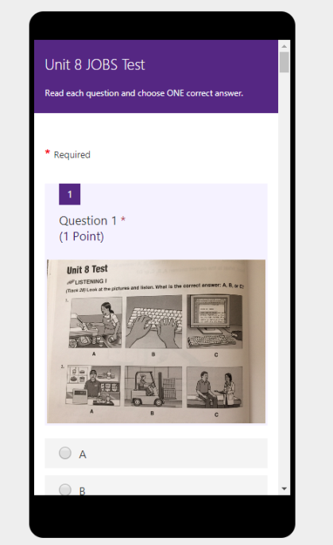
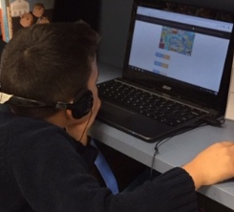
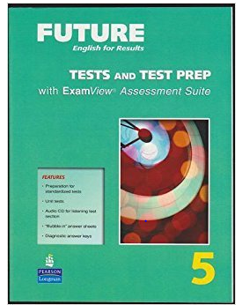
Test Taking: Skimming and Scanning for Reading Comprehension Skills using Microsoft Forms and Speaking Practice Using Lingt.com
How can we best prepare our students?
Presenter: Amy L. Watkins

Slide 2
Objective: Teachers will be able to use at least one type of test prep with their students.
What do you already know or want to know about Microsoft Forms or Lingt.com?
How do you prepare your students for the listening and reading tests?

Slide 3
Book Clubs with Microsoft Forms
Inspired by Eve McCarey: Using Social Justice Themes to Inspire and Engage Students. Inspired by my Great Grandmother to use “What Was Ellis Island?”
Once a week the team or the pair of students would meet. They would skim and scan the book for the answers to the questions I prepared for them.
I collected the students’ e-mail addresses, sent out the link and then they would answer the questions on the computer. The link could also be shared through Edmodo. We did it in parts so usually 2 chapters at a time.

Slide 4
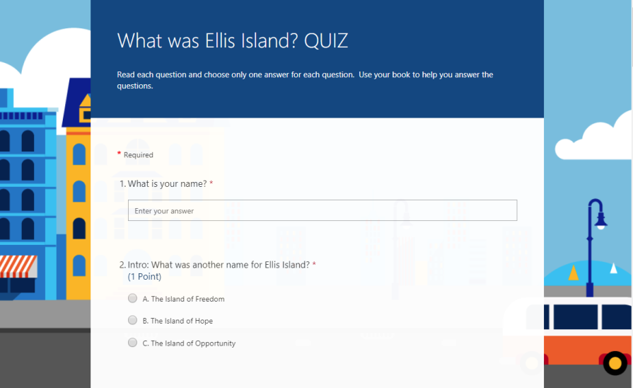
Book Clubs with Microsoft Forms
PROS
Encourages Collaboration: Students work with a partner or a group.
Gives students an opportunity to practice the skimming and scanning skill.
Opportunity to practice time management in a test taking situation.
Encourages reading different texts.
CONS
You might need to purchase the books yourself.
You might need to create the questions yourself.
Might not have computer or smart phone access.
Human error entering the right answers.
All students might not have an e-mail address or it might be difficult for all students to access the link.

Slide 5
Unit tests with Microsoft Forms
Inspired by Simon Lee who included the Tests and Test Prep book in my books that I picked up to use for my class.
At the end of each unit the students would take the Unit Test from the Test Prep book.
I wanted to find a way to not have to use paper, I wanted the students to have immediate feedback and practice answering questions on the computer.
It was an easy way for me to assess students’ strengths and weaknesses.

Slide 6
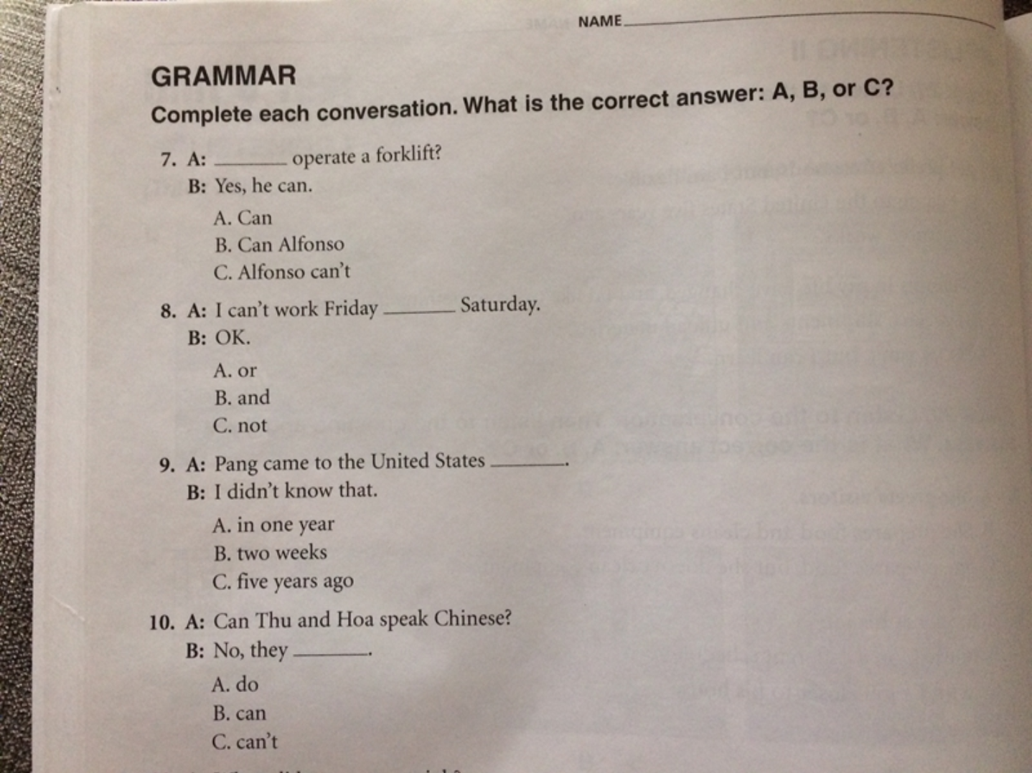
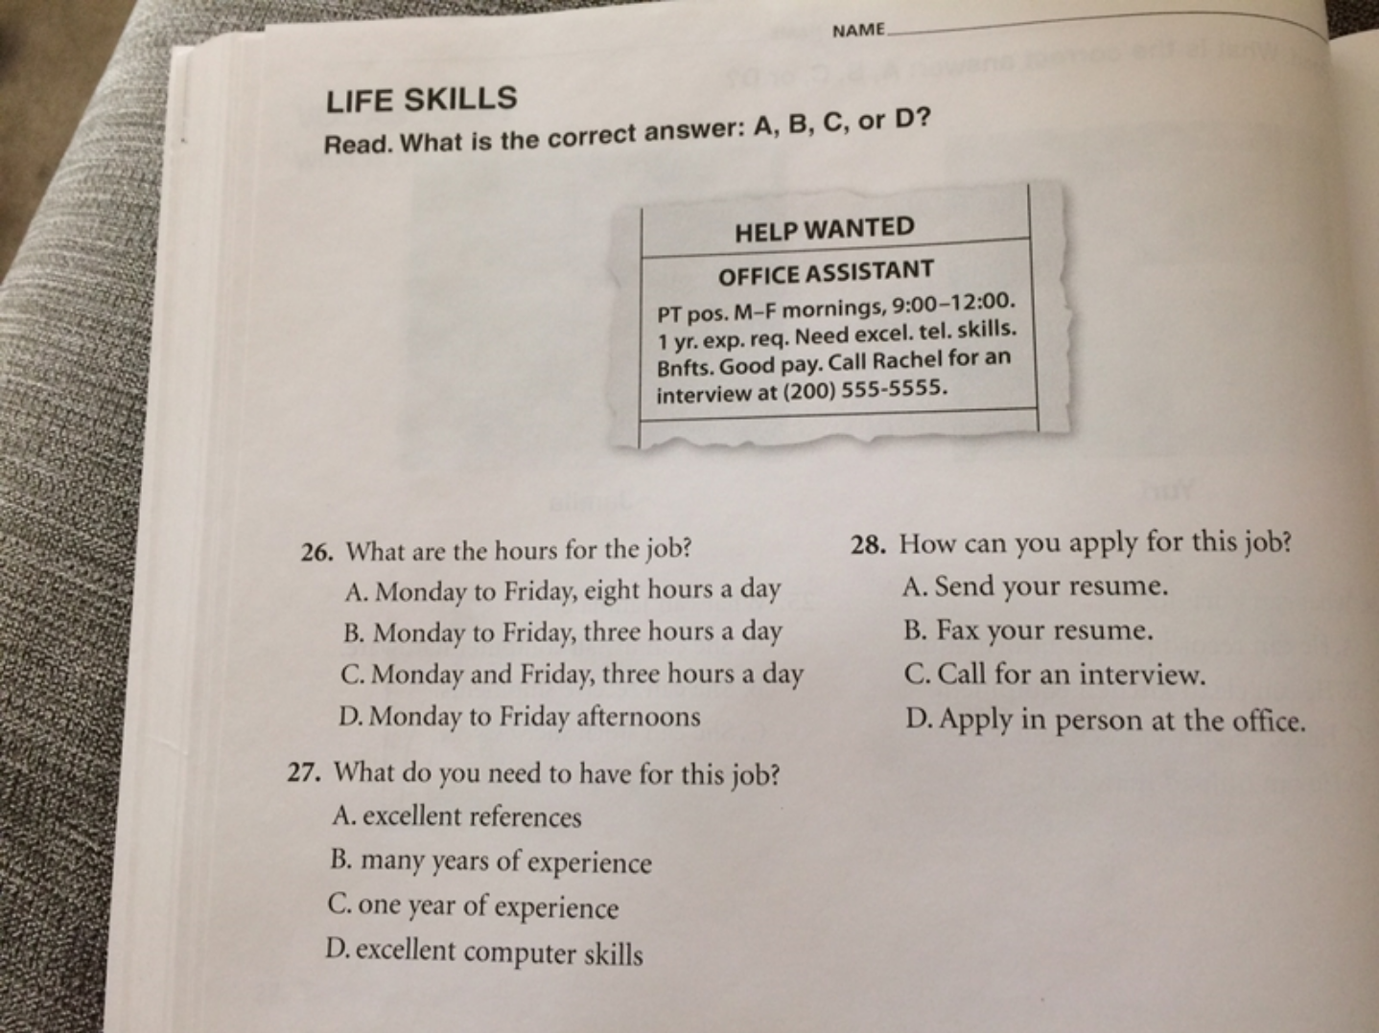
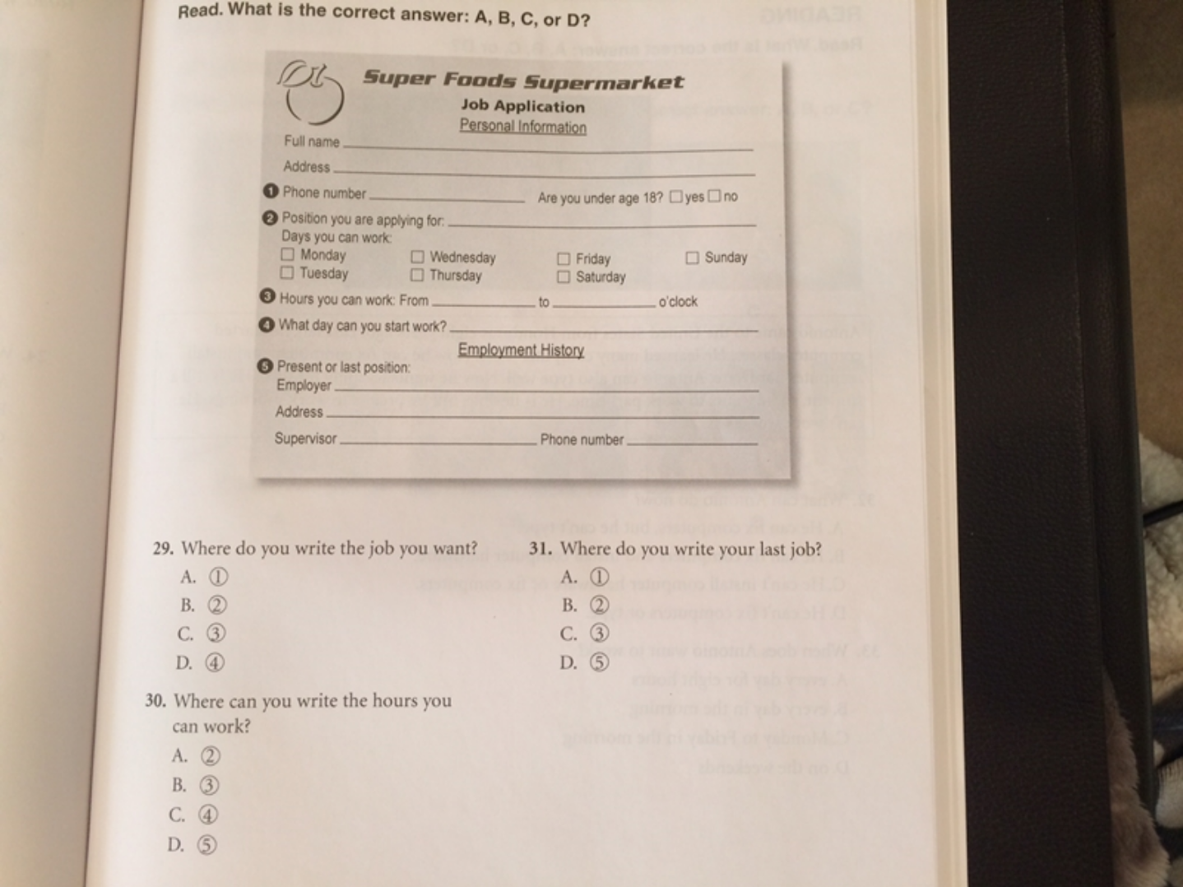
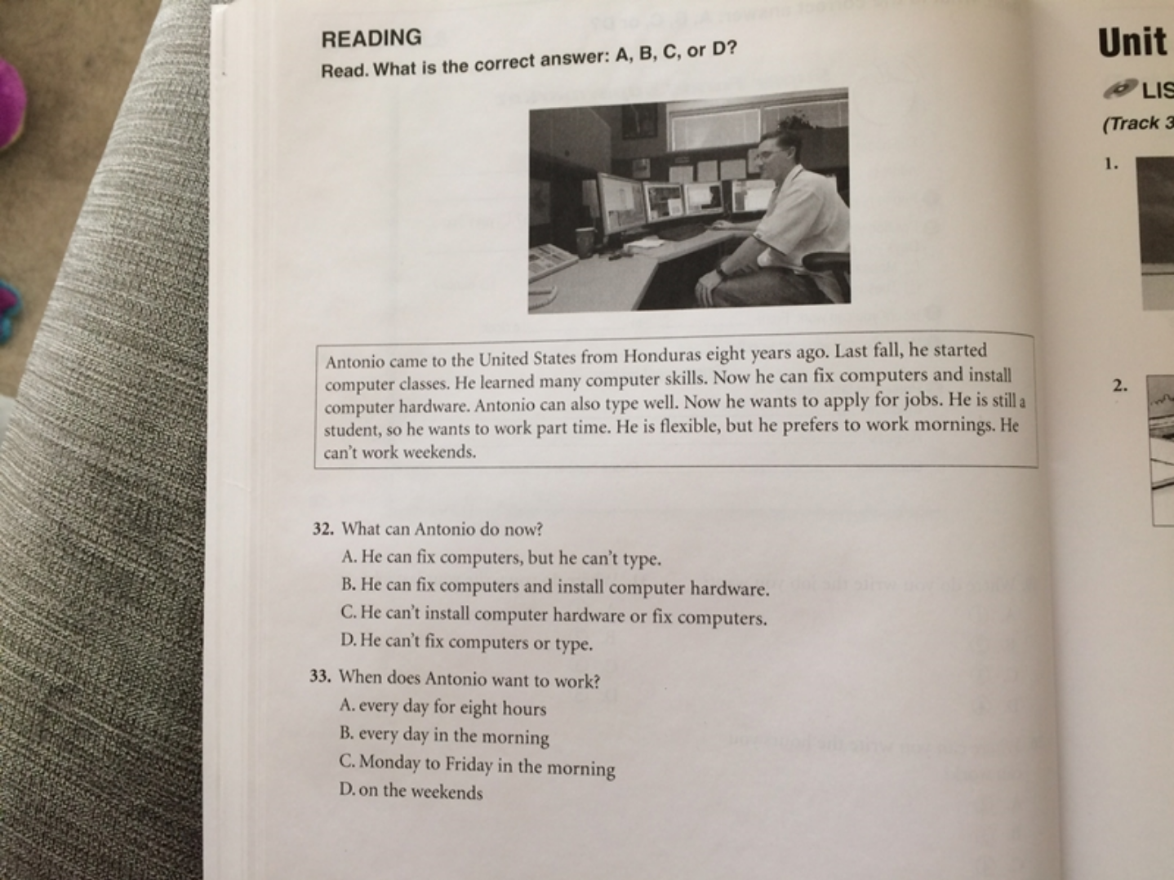
Based on the results these 4 questions seemed to be the biggest need in terms of re-teaching:
Unit 8 Jobs Test
#8 5/10 Grammar, using “or”
#16 5/10 Using “can” and help wanted ad abbreviations
#18 2/10 Complete a job application
#22 5/10 Skimming the text for details

Slide 7
Unit Tests with Microsoft Forms Example: Unit 2 Test on the Family Intermediate I https://forms.office.com/Pages/ResponsePage.aspx?id=Cx5ATVJlCE69OKjRXKDd2aSXHZOJU_9GvZ9FELo7tcRUNDY5U0Q2Q09EWDVLVU5VTVNTTUNNSDFTNi4u
PROS
Makes students more comfortable when they’re in a real testing situation.
Gives students immediate feedback.
Provides an opportunity for students to practice skimming and scanning.
Allows for discussion about the correct/incorrect answers.
Provides teachers data on the students’ strengths and weaknesses.
CONS
Teachers need to carefully choose the questions that best meet the needs of their students.
There may be a need for paper copies as well.
Takes time to create the form.
Human error when entering the correct answers.
All students might not have an e-mail address or it might be difficult for all students to access the link.

Slide 8
Speaking practice with Lingt.com
Inspired by Matilda Bediako.
I did this one on one with a Beginning II class. As the teacher was instructing I called out one student at a time to use the chrome book to answer the questions.
Students don’t need to use class time for this. It can be done on a phone through the app or on a computer with a microphone.

Slide 9
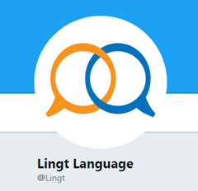
Speaking practice with Lingt.com Example: Introduction Beginning II https://www.lingt.com/ms.%20watkins/mc-esol-intermediate-i-sum2018/83448/intermediate-i-summer-2018-introduction-92/
PROS
Students get immediate feedback.
Teachers can create it to meet the needs of their students.
Provides teachers data on the students’ strengths and weaknesses.
Gives students an opportunity to hear the teacher speak, repeat it and then hear themselves and correct themselves immediately.
CONS
The app doesn’t always work on the phone.
Possibility of having to do this one at a time.
Time for the teacher to listen to each individual response.
Teachers need to create the questions.

