Slide 1
Maximizing Student Engagement and Speaking Practice through Flip (formerly Flipgrid)
16th AELG Annual Spring Conference
Misun Sasse Nilsson​​
04/15/2023

Slide 2
Agenda
Meet the Presenter​
Survey: Your Thoughts
Introduce FLIP
Showcase Students’ Videos
Practice: Your Video
Conclusion

Slide 3
Meet the presenter
Misun Sasse
Since 2011, I have been teaching ESL at all levels of the AELG program as an ESL instructor. My research focuses on the impact of technology and e-learning in education.

Slide 4
Survey: Your Thoughts
​

Slide 5
Question 1.
How much do you talk in your class?
A
B
C
D
Less than
50%
Less than
60%
Less than
70%
Less than
80%

Slide 6
Question 2.
How much teacher-talk do you think is ideal during class time?
A
B
C
D
Less than 30%
Less than 50%
Less than 60%
Less than 70%

Slide 7
Question 3.
What strategies/techniques do you use to increase student-talk time?

Slide 8
Challenges
Limited class time
Shy students to speak

Slide 9
Flip: Help Overcome the Challenges
Engagement is essential for language learning.
There are many factors that can influence engagement, such as motivation, anxiety, and self-efficacy.
There are a variety of activities and tasks that can be used to engage students in language learning.
Mercer, S., & Dörnyei, Z. (2020). Engaging Language Learners in Contemporary Classrooms. Cambridge University Press.

Slide 10
Overview: What is Flip?
• Flip is a video discussion platform that allows teachers and students to engage in asynchronous video conversations.
• Flip is easy to use and accessible for teachers and students to participate from their own devices.
Conference Presentation

Slide 11
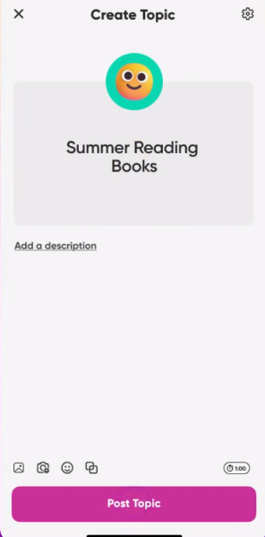
What are the features of Flip?
• Group & Topic creation: Teachers can create groups and topics and invite students to record videos in response.
Conference Presentation
11

Slide 12
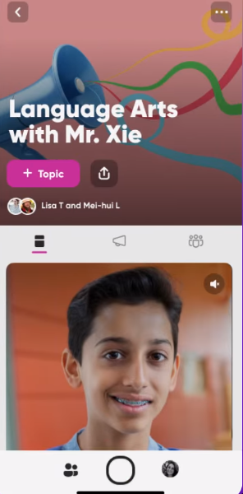
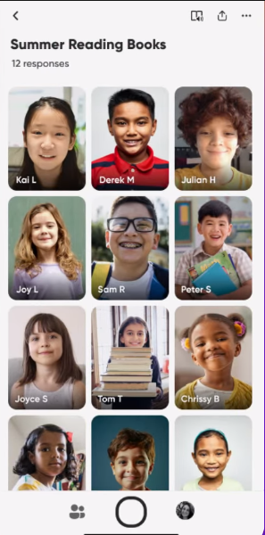
What are the features of Flip? (Cont.)
• Video recording: Record videos of themselves speaking on a given topic
• Video moderation: Teachers approve or reject videos
• Video sharing: Shared with the class for others
• Video commenting: Leave comments on each other's videos
• Video analysis: Flip provides analytics and insights
Conference Presentation
12

Slide 13
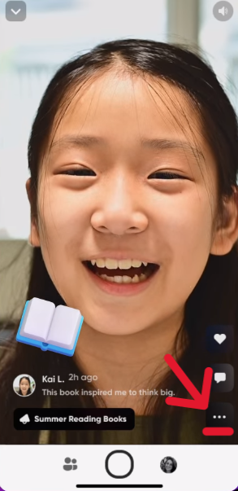
What are the features of Flip? (Cont.)
• Integration: Flip integrates with other learning management systems (LMS), blog or website.
Conference Presentation

Slide 14
What are the benefits of using Flip?
Engagement: Flip boosts student engagement with asynchronous video chats.
Accessibility: Flip can be used on any device by teachers and students.
Speaking Practice: Flip helps students practice speaking in a safe and supportive environment.
Collaboration: Flip promotes collaboration and social interaction among students.
Accountability: Flip provides insights on student participation and engagement.

Slide 15
Differences between Flip and other video platforms
Free
Education-focused
Easy, simple, creative
Mobile-friendly
Microsoft tool (integrate with Google Classroom)

Slide 16
Possible challenges of using Flip
Alternative methods for students uncomfortable with video:
Audio recordings
Written responses
Recording with only hands or object

Slide 17
Practical examples of using the FLIP
Focused
1-minute speeches on specific topics
Practice
Prepare and practice short speeches
Interactive Role-play real-life situations​
Feedback
Provide feedback on speaking skills

Slide 18
Practical examples of using the FLIP
Focused
Introduce yourself
Practice
Occupations
Low Levels
Interactive Ordering food from a menu​
Feedback
Provide feedback on speaking skills

Slide 19
Practical examples of using the FLIP
Focused
Goals
Pronunciation
Practice
Elevator speech
Job interview
High Levels
Interactive
Small talk
Resolve conflicts​
Feedback
Provide feedback on speaking skills

Slide 20
Showcase: Students’ Videos
Favorite things (Low level)
Tell me about yourself (Job interview question)
Teacher’s feedback
Pronunciation (High level)
Elevator speech (High level)
Team project (High level)

Slide 21
Practice: Your Turn
Learn a new language
Practice before recording
Record yourself in Flip
Share

Slide 22
Learn Korean
What’s your name?
내​
이름은
_______​
입니다.​
Korean
nae
i-reum-eun
im-ni-da
My
name
is
_______​.
English

Slide 23
Learn Korean
What’s your name?
내​
이름은
_______​
입니다.​
Korean
nae
i-reum-eun
im-ni-da
Flip link: https://flip.com/272c7dd5

Slide 24
What do you think?
Learning Korean
Speaking Korean
Recording in Flip
Let’s share!
​

Slide 25
Conclusion: Is Flip a good resource?
Flip is a user-friendly and versatile platform that promotes engaging and interactive learning experiences.
Flip provides a unique way to encourage participation, collaboration, and critical thinking skills.
With Flip, teachers and students can experience a new level of interaction and engagement with each other's ideas and thoughts.

Slide 26
Questions?

Slide 27
Thank for your participation!

