Slide 1
Integrated Mobile-Friendly Learning Activities to Enhance Your Instruction
Presenters:
David Reed & Kwelli Sneed

Slide 2
Objective
The session will provide an overview of Socrative.com mobile technology to incorporate technology in instruction, which will provide as an assessment tool for instructors.

Slide 3
What is Socrative?
Socrative is a smart student response system that empowers teachers by engaging their classrooms with a series of educational exercises and games.
Socrative apps are super simple and takes seconds to login.
Socrative runs on tablets, smart-phones, and laptops

Slide 4
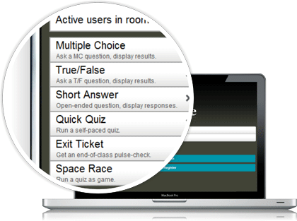
SIMPLE & SMART
Socrative is a smart student response system that empowers teachers by engaging their classrooms with a series of educational exercises and games.

Slide 5
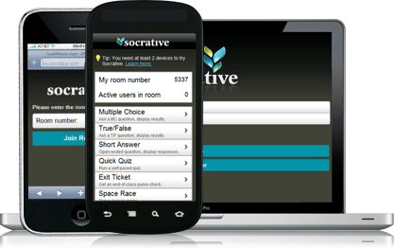
ENGAGING Teachers login through their device and select an activity which controls the flow of questions and games. Students simply login with their device and interact real time with the content.

Slide 6
REAL-TIME FORMATIVE ASSESSMENT
Take a snapshot of student thinking through real time formative assessment.
It's super easy to gather responses and get whole class participation.
Just choose your question type, ask a question, and wait for responses:
Multiple Choice.
True or False
Short Answer

Slide 7
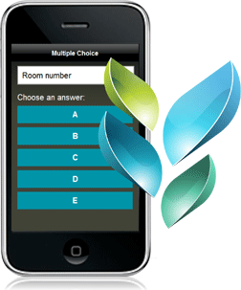
FORMATIVE ASSESSMENTS
Multiple Choice
Present students with a MC question and see the results populate the bar chart as students select their answer.

Slide 8
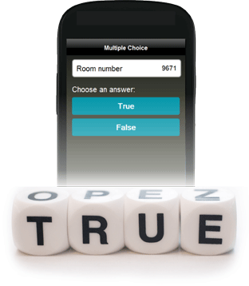
TRUE OR FALSE
Ask a T/F question, see the results, and discuss the choices as they come.

Slide 9
SHORT ANSWER
Gather open ended responses to any question you ask. Instantly project the student responses and then let students vote on the content.

Slide 10
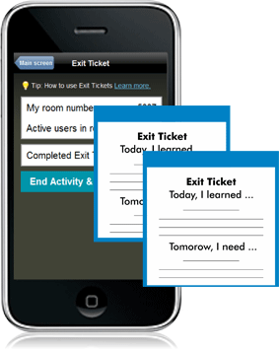
EXIT TICKETS
Check in on your students‘ understanding as they head out the door.

Slide 11
ASSESSMENT
Student responses are visually represented for multiple choice, true/false and Short Answer questions.
For pre-planned activities a teacher can view reports online as a Google spreadsheet or as an emailed Excel file.

Slide 12
Create Your Own Questions in Minutes
Design your own evaluation exercises in minutes by importing questions or in putting them on the website. Save them in your account so you can access them anytime.
Questions can be multiple choice, short answer, or a combination of the two.
It's your choice!

Slide 13
NO NEED TO PREP
Take advantage of pre-designed activities to gather thoughtful student data.
Receive the responses in an emailed report or as an online Google spreadsheet.

Slide 14
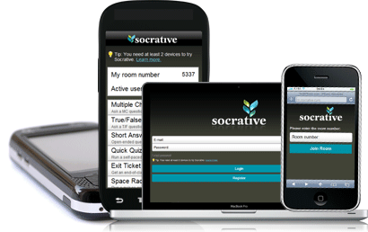
Works With All Web-Enabled Devices
BROWSERS
APPS
Find our apps in the Google Play or iTunes stores
Log in to Socrative on any internet browser.

Slide 15
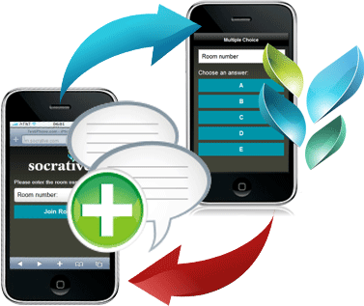
Enjoy the Energy of the Moment
Engage your students in fun exercises that track their performance while they're playing. Enjoy the energy of the moment and get the results sent to you by email.

