Slide 1
Culturally responsive teaching
Montgomery college
AELG Spring conference
April 9, 2022
Presentation by: betsy ljubic

Slide 2
Introduce yourself in the chat
In the chat, write your name, where you grew up, and one adjective that describes you.

Slide 3
Session facilitator bio
Grew up in Martinsburg, WV. I now live in Frederick.
Attended undergrad in South Carolina and Pennsylvania
Ten years teaching EFL and doing humanitarian work in Croatia
M.Ed. degree in Curriculum & Instruction, ESOL
9 years teaching high school ESOL, 1 year at MC, 6 years at FCC
2 kids, 2 cats, 2 dogs
Passionate about culturally responsive teaching and student care, student advocacy, and issues of equity and access for ELLs.
Advanced Croatian speaker, intermediate Spanish speaker

Slide 4
Norms for our time together
Experience discomfort
Take risks
Stay engaged
Listen for understanding
Speak your truth
Accept and expect non-closure
No fixing
Confidentiality

Slide 5
Session objectives
Be able to explain conscious and unconscious bias and be aware of your own biases.
To know your own cultural identity and how that impacts your teaching.
To explain culturally responsive teaching .
To review a variety of culturally responsive teaching strategies.

Slide 6
Defining conscious and unconscious bias
Bias: To believe some people or ideas are better than others.
Conscious bias: Bias we are aware of.
Unconscious bias: Bias we are unaware of.
There is no blame on anyone for unconscious bias, the only thing we can do is be aware of it and explore it.

Slide 7
A Resource to share https://implicit.harvard.edu/implicit/selectatest.html
What are your biases?
What surprised you the most about your results?
What do you agree most with?
What do you disagree with?

Slide 8
Brainstorm – what shapes our biases and our cultural identity?

Slide 9
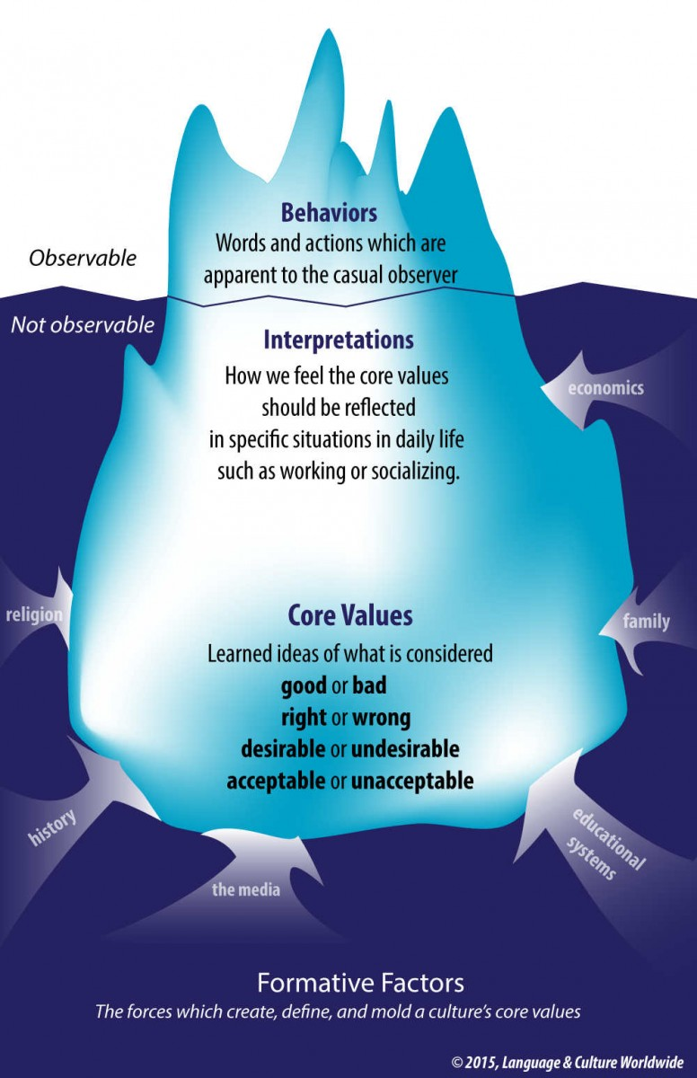
What is culture?

Slide 10
Food for thought:
"Becoming aware of how your cultural expectations may differ from those of your ELs is a two-part process that will lead you to becoming a more culturally competent educator. The first part of the process is to reflect on the cultural values and beliefs that shape your expectations in the classroom. The second part of the process is learning more about the ELs you work with and recognizing how their values and beliefs may be different from your own."
(Fenner & Snyder, 56)

Slide 11
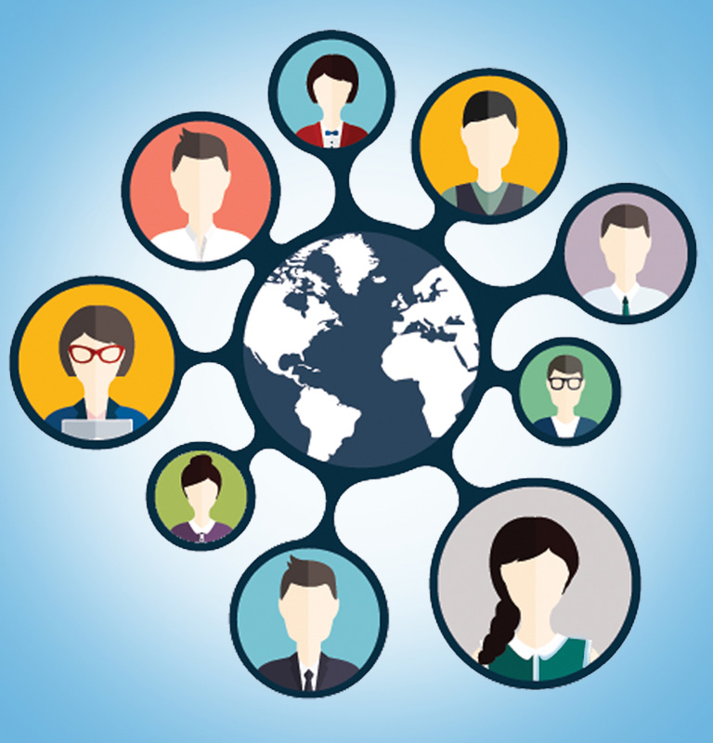
Your cultural identity-- Make a list of all the groups to whom you belong, then think about our students
Language
Marital status
Nationality
Physical appearance
Political affiliation
Race
Religion
Sexual orientation
Socioeconomic status
Ability
Age
Gender
Ethnicity
Education
Family Status
Geographical location
Immigration status

Slide 12
My multicultural self- discussion questions
Make a list of all of the cultural groups that you belong to (e.g., Mexican American, female, Jewish, gay). Then, consider which ones you identify with most, and put a star next to those.
Describe a time that you felt proud to be a member of one of these cultural groups.
Describe a time that you found it challenging to be a member of one of these cultural groups.
What made the difference between the two times?
Breakout Rooms to discuss.

Slide 13
Cultural differences in the classroom:
Punctuality
Individualistic vs collectivist learning (example: Covid response)
Communication with teacher
Non-verbal communications, gestures
Plagiarism

Slide 14
How do we implement an asset vs. Deficit mindset?
We leverage the cultural and linguistic capital (and all other kinds of capital) that our students bring into the classroom.
There are many ways to leverage cultural and linguistic capital and be more culturally responsive, today we will examine a few.

Slide 15
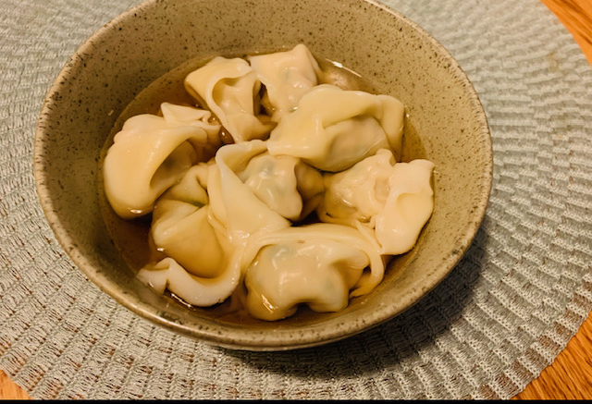
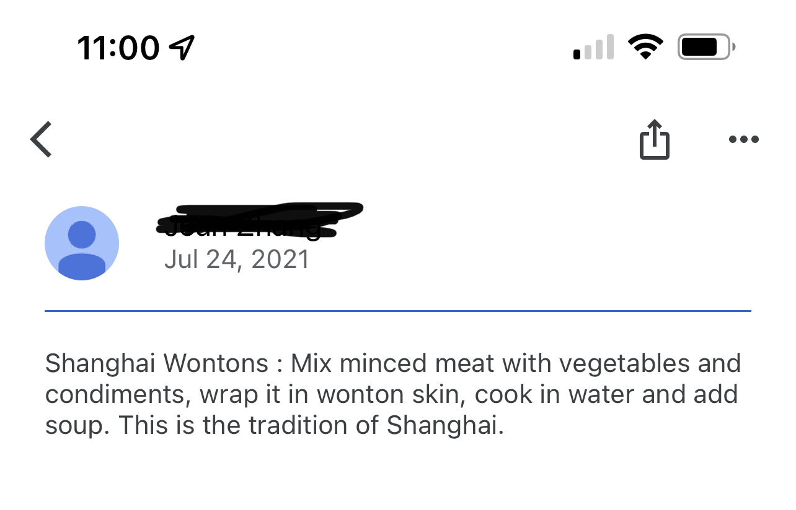
Build a cultural knowledge base – this will look different at different levels. Basic level
All About Me Presentations
(High Beginning – Intermediate)
Student Sample: https://docs.google.com/presentation/d/1W58FPWGAopKj1-7fhRYVHf8p0tRqdlIu5tzxUZc_z0Q/edit?usp=sharing
Folktale or Story Retelling
Student Sample:
https://express.adobe.com/video/LpCxw8Z2vzAdu

Slide 16
Use multicultural media or texts
Multicultural Texts: "The Elote Man Goes to College" is a book about a street vendor named Diego. By selling the corn popular in the Mexican American community, he's able to send his daughter, Marisol, to college.
Representing the cultures in your class
Incorporating news stories from different parts of the world (VOA, Newsela, etc.)
Encouraging our students who are parents to affirm and encourage bilingualism and multilingualism with their children.
Cultural Unit: Cultural Unit Example Lesson
The Case for Multilingualism

