Slide 1
Teaching Science in Math Classes
Mengsteab Weldegaber
mengsteab.weldegaber@montgomerycollege.edu
AELG, GED Program Instructor
Spring 2020 Conference – 30 May 2020

Slide 2
Outline
Introduction (Motivation)
Objectives
Connecting Math with Science
Conclusion

Slide 3
Introduction (Motivation)
Most student in the AELG, GED Program ask about Science.
Independently prepare for Science GED test is a challenge to adult students.
Objectives
Teachers will be able to connect Math ideas with Science and real world.
Students will be able to build deeper understand-ing in math skills and remain engaged in the learning process.

Slide 4
Question
Do our students understand why and how their Math skill will apply outside of the classroom?
Answer: Math is everywhere:-
Building Design & Architecture
Medicine
Urban Planning
Electronic Music Production
Auto Transportation Design
Fashion Design
Managing Money
Weather Forecast
Science & Engineering

Slide 5
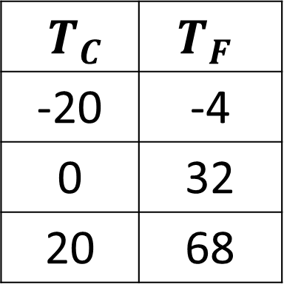
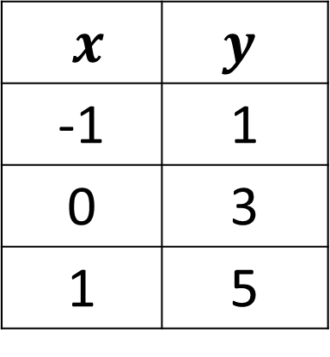
Connecting Math and Science
Examples
1. Linear Equation ⇔ ºC into ºF
Math
Science
$$T_{F}={\frac{9}{5}(T}_{C})+32$$
$$y=2x+3$$
$x$ | $$y$$
-1 | 1
0 | 3
1 | 5
$T_{C}$ | $$T_{F}$$
-20 | -4
0 | 32
20 | 68

Slide 6

. . . Connecting Math and Science
2. Slope of a Linear Equation
$$m= \frac{rise}{run}= \frac{y_{2} − y_{1}}{x_{2} − x_{1}}$$
$$rise=4$$
$$m= \frac{4}{2}=2$$
$$run=2$$

Slide 7
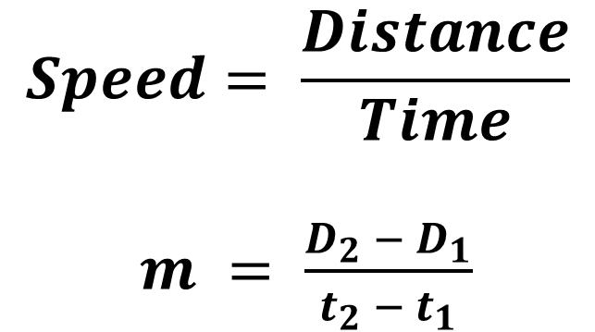
. . . Connecting Math and Science
Speed: Distance-Time Graph
$$D(mi)$$
$$80$$
60
40
20
$$rise=80$$
$$Speed= \frac{Distance}{Time}$$
$m = \frac{D_{2} − D_{1}}{t_{2} − t_{1}}$
1 2 3 4
$$t(hr)$$
$$run=2$$
$$m=Speed= \frac{80}{2}=40 mi/hr$$

Slide 8
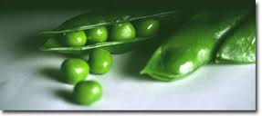
. . . Connecting Math and Science
3. Using Probability and Punnett Squares to Work Genetics Problems
Pea Plants
The gene for the height of pea plants occurs in a Tall (T) form and in a Dwarf (t) form.
The different forms of a gene are called allele.

Slide 9
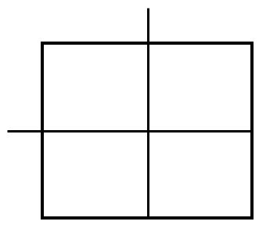
. . . Connecting Math and Science
Punnett Squares for Pea Plants
A Punnett square is a diagram showing the allele combinations that might result form a genetic cross between two parents.
The alleles of the first parent are placed across the top and that of the second parent are placed along the left side of the square.
Punnett Square
T
t
T represents dominant
alleles and
t represents a recessive
alleles.
T
TT
Tt
t
Tt
tt

Slide 10
Science Questions & Math Answers
The genotype of the two parents are given to be Tt
Questions
What chance is there that an offspring pea plant will be short?
2) What chance is there that an offspring pea plant will be tall?
Answers
$$\frac{1}{4}=0.25=25\%$$
$$\frac{3}{4}=0.75=75\%$$
T
t
T
TT
Tt
Punnett Square
t
Tt
tt

Slide 11
Conclusion
Teaching Science/Real-world applications in mathematics are most effective at engaging student interest in and recall of material.
Keep Math relevant and fun to teach/learn.
Deeper understanding of Math skills will help students prepare for GED Science Test.

