Slide 1
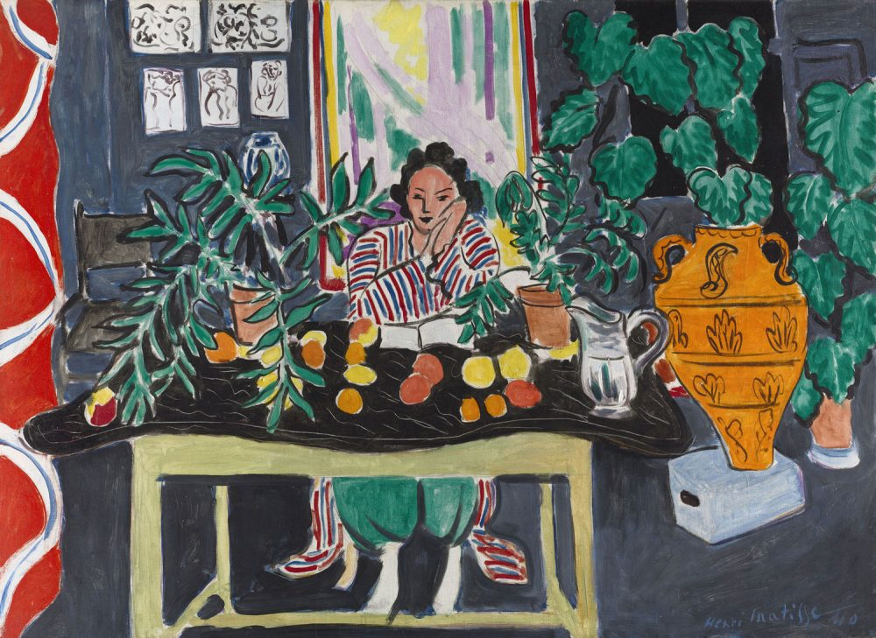
VisuaL Arts to Spark Interest and Learning

Slide 2
Session Agenda
Research on Arts Integration in the ESOL classroom
Art Activities to try in ESOL classes
Ways to Assess Language Learning through Art Activities
Resources to help plan art lessons and activities

Slide 3
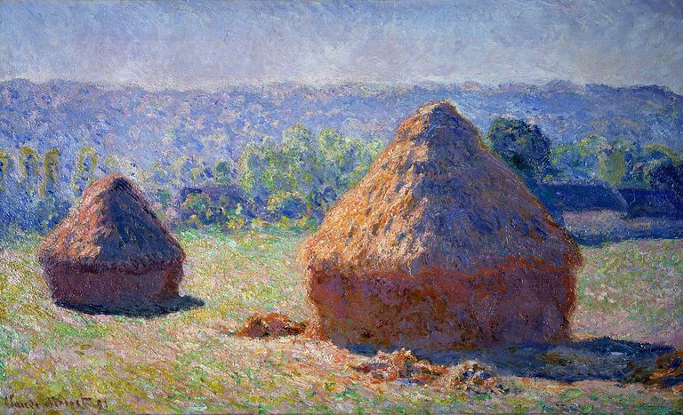
Session Objectives
Identify reasons for incorporating Visual Arts into adult ESOL
Learn about art activities to use in multi-level classrooms
Identify ways to assess student learning in art activities
Access online resources to enhance learning through the Arts

Slide 4
Why the Arts in ESOL Teaching
Research shows that integration of art into the ESOL classroom can:
Open up different ways of thinking
Promote creative problem solving
Open doors for higher levels of critical analysis
Enhance language development with non-verbal methods of communicating
Stimulate other ways of learning and tap into alternate learning styles (kinestetic, tactile, visual)
(Gardner, 2014, The Love of Art in Correctional Education – Endless Possibilities for Critical Literacy;
NY State Ed Dept, 2010, Art as a Tool for Teachers of English Language Learners)

Slide 5
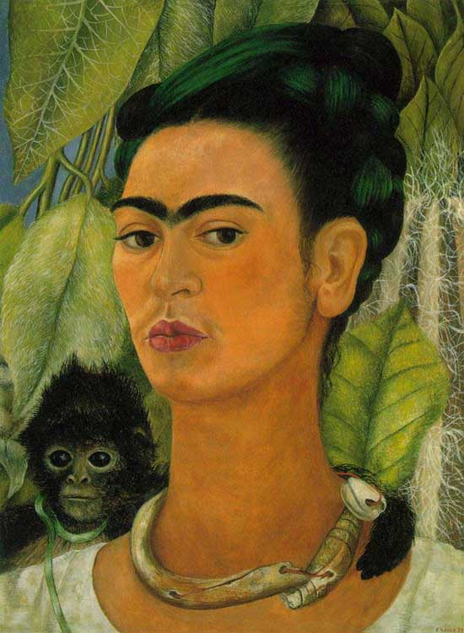
Art as the ”Text”
Art is the visual document that all students can “interact” with simultaneously in the classroom
Art can be used as the “source” to practice critical thinking skills
Art offers alternatives to traditional text-only to enhance verbal and written communication
Art as a universal language, that can bridge written and spoken language

Slide 6
Art in the classroom
Art activities can be interwoven in existing language lessons focusing on Speaking, Listening, Reading, Writing, Grammar, Pronunciation, Vocabulary
Art activities can be the focus of the lesson by incorporating one or two language components (e.g., Reading and Writing)
Art is a multi-cultural approach to encourage community building
An array of art materials can be available for students and art projects can stretch over several class sessions

Slide 7
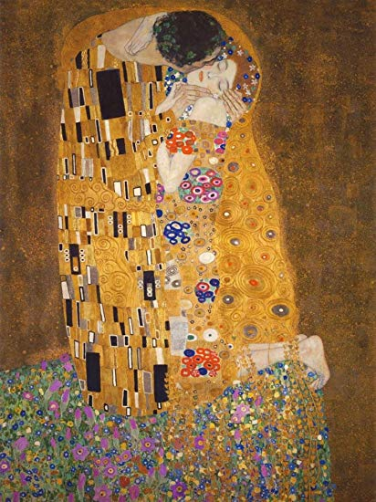
Art Activities for Online Classrooms
Landscape drawing using partner dictations
Reflection writing about paintings and other art works
Speaking activities – describing details and emotions in paintings
Reading art-related articles
Individual presentations sharing arts from home countries
“Step inside paintings” – create questions to ask painting subjects

Slide 8
Class Demonstration: “Come to Your Senses” Lesson
Teacher presents on painting from Brazilian wildlife
Students identify 5 ways to experience the painting (sight, sound, etc…)
Students learn new vocabulary and describe (orally and written) what they are seeing, hearing, etc...
Students gather fruits or vegetable from home and descrie to partners the item using all senses

Slide 9
Assessment and Follow Up
Different methods to assess learning including:
“Exit tickets” through specific questions
Dictations through drawings
Partner interviews about reactions to art
Follow Up Class :
Student presentations sharing “art” or all types from home countries
Question and Answer sessions for students to explain art forms

Slide 10
National Gallery of Art Lessons
Imaginative lessons using artworks and activities to build comprehension, speaking, and writing skills
https://www.nga.gov/education/teachers/lessons-activities/ell-beginner.html
https://www.nga.gov/education/teachers/lessons-activities/ell-intermediate.html

Slide 11
Other Resources
www.getty.edu/education/teachers/classroom.../esl/esl_lesson_plan_index.html
https://www.fluentu.com/blog/educator-english/esl-art/
https://www.bookshark.com/blog/virtual-art-museums/
https://artsandculture.google.com/
App – SmARTify

Slide 12
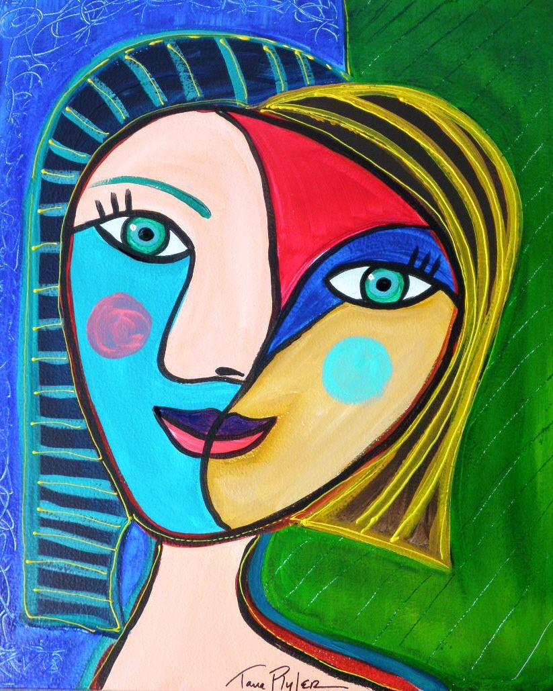
Hope you give Art a try!
Contact me if you have questions or for more resources:
Carol Woodside
carol.woodside@montgomery
college.edu
Thanks!!

