Slide 1
Sing! Incorporate songs and music into your classroom even if you can’t hold a tune
You’re listening to Chillhop Essentials:
https://bit.ly/36JsJkP
Carmen Durham and Janet Hughes

Slide 2
Why music?

Slide 3
Reasons to present music
Music connects across cultures and breaks down barriers
Getting to know music is getting to know the culture and language
Pronunciation, Idioms
Learning the lyrics of a song helps you to expand your vocabulary
Notes:
There are a lot of reasons to use music in your class, but what I’ve found over Zoom is it’s a nice way to relax and laugh and move around if students want to. We all sing badly and laugh.

Slide 4
Reasons to present music
Simple basic essential phrases to get by (hook) (Can’t touch this!)
You can take music with you anywhere and practice it on the move
You can put your whole body into it, let down your guard, and have fun!

Slide 5
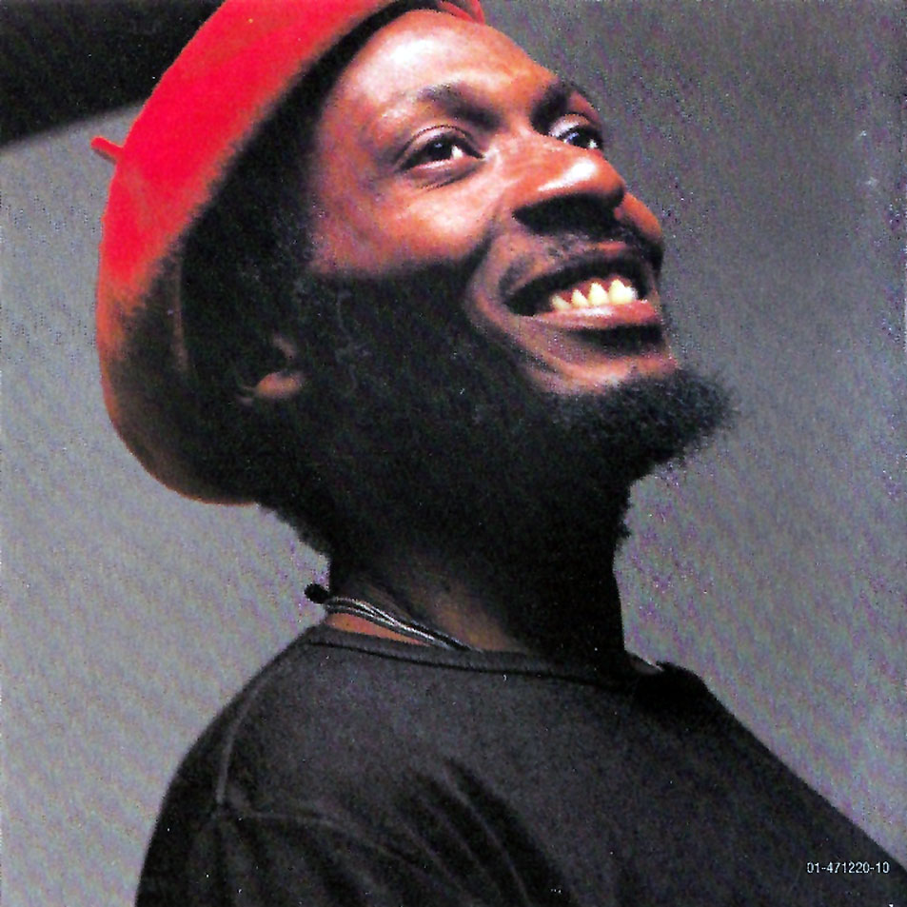
You Can Get it if You Really Want!
How to embed a video in a PPT: https://www.youtube.com/watch?v=09d3A9Mj8oQ
Don’t forget to click “Enable Content”

Slide 6
Tech access, different levels, and delivering the lesson

Slide 7
No tech, Low-tech, High-tech
Instructor led songs: Easy songs that the instructor can manage and sing repetitively.
Example: “This Land is your Land” Chorus
Low-Tech
High Tech
No Tech
Instructor shares computer sound and/or lyrics on the screen.
Instructor pulls up YouTube and shares computer screen to play the song.
Providing copies of lyrics is great anytime!
Tips:
Once students are ‘strong’, play it karaoke style.
Students complete a fillable version of the lyrics on their phones.
Download a song or play from YouTube.
Write words on (virtual) whiteboard.
Embed video into a website or presentation.
Share your computer sound and screen on Zoom

Slide 8
Differentiating for Levels
Slow songs
Intermediate
Advanced
Beginner
Focus on vocabulary and themes
All of these AND MORE
Tell students beforehand what to listen for
Tips:
Easy questions
Focus on specific vocabulary more than the theme of the song
Discuss personal connections to the theme of the song
Justify opinions
Analyze the themes of the song
Give students choice to pick out new vocabulary words they hear
Remind students they don’t have to understand all the words

Slide 9
Various ways to present music
Before listening
Define/draw important vocabulary words and play a game to review the words (e.g., taboo, bingo)
Discuss the general theme of the song (e.g., Name a time you felt worried)
Go over important grammar and have students take note of this grammar during the song
Listening
Share your screen AND COMPUTER AUDIO when you play a song, and share the questions that students needs or the lyrics for Karaoke
Listen to the song a few times with different activities each time
Students can use Zoom functions to write on the screen or a whiteboard
Play the song in pieces. Repeat a piece if needed

Slide 10
Activities while listening
Dictation: Students listen and write down the lyrics. Can be done individually or as a teacher led activity.
Multi-level dictation: Share with each other to get all words right.
Cloze activities: Hand out lyrics with words missing, have the students listen and fill in the blanks.
Sentence sort: Cut up lyrics into sentences, distribute into groups and play the song while they arrange sentences.

Slide 11
Activities while listening
Whole group: Cut up lyrics into sentence strips, each person has one sentence, when they hear their part, they get into ‘order’.
Videos: Watch the music video and discuss clothing, instruments, people’s characteristics, etc.

Slide 12
And more…
Writing exercises to continue the song
Create adaptations of the song with new words
Filler activity: Have a few extra minutes before class is over or after the break? Pull up a song and sing it!

Slide 13
Various ways to present music
After listening
Put students in small groups with break out rooms (They may need to write down the discussion questions on their paper first)
Discuss the theme of the song (e.g., Have you ever felt like the singer of this song?)
Complete comprehension questions to understand/analyze the song
Give opinions (e.g., Do you like this song? Why or why not? How would you describe this song using adjectives?)

Slide 14
Teaching on Zoom
Make sure to share your screen AND SHARE COMPUTER AUDIO
Mute students
Send students the lyrics/websites ahead of time or put them on Edmodo/Google Classroom for easy access. Then students can use these websites for homework, too.
Have students do an online activity OR draw on the screen or virtual whiteboard instead of only writing on their own paper.
Put students in breakout rooms to collaborate on “Before listening” and “After listening” activities.
It’s best to listen to the song together as you share your screen/audio.

Slide 15
Words of wisdom from our teaching

Slide 16
How to choose a song
Look for a song with an easy chorus for the lower-level learners
This Land is Your Land chorus
Find songs about a specific theme/topic you are covering in class
Find songs that use a specific grammar tense
Colors - What a wonderful World
Imperatives – Wavin’ Flag

Slide 17
Words of wisdom
Pop songs are great, but you have to be aware of the odd vocabulary, slang and sexual innuendo that should be avoided in the classroom
Read, read, read, read the lyrics first – don’t rely on your memory for a ‘fun song’
The best songs are inspirational, and are adult songs
Look for songs with aspirational vocabulary but not PhD level

Slide 18
Words of wisdom with tech
Create your own online quiz:
Eslvideo.com
Look online to see if someone has already created a worksheet and MAKE SURE IT’S APPROPRIATE FOR YOUR CLASS/LEVEL/ACADEMIC SETTING
Google the name of the song and ESL and/or worksheet (e.g., Wavin’ flag ESL worksheet)
ESLVideo.com
Lyricstraining
Make sure you’re sharing your computer sound!
On YouTube, let the commercial play BEFORE sharing your screen/audio
Embed a video into a website or presentation for easy access (for you and students)

Slide 19
Count on me…

Slide 20
Examples from our classrooms

Slide 21
Great songs to teach
What a Wonderful world
Count on Me
You Can Get It if You Really Want
I can see Clearly Now
Wavin’ Flag
Don’t worry, Be happy
This Land is Your Land
Hello, Goodbye
Our House
Imagine

Slide 22
Breakout Rooms
As a group, come up with 5 songs that you think you could use in class. Be ready to share.
After, we will share a handout with activities we’ve used.

Slide 23
Websites… for more…
https://www.lyricsgaps.com/
https://www.eslvideo.com/
https://lyricstraining.com/
http://www.fluentu.com/english/educator/blog/songs-for-teaching-english/
http://www.esl-lounge.com/songstop.php
http://www.fluentu.com/english/blog/easy-english-songs/
http://www.isabelperez.com/songs.htm
http://www.eslcafe.com/idea/index.cgi?display:1083534764-72313.txt

Slide 24
Q & A, Comments, Suggestions
Video link https://www.youtube.com/watch?v=KSuB4t3q_dA

